Slide 1


Machine learning made easy(er)
YOU can be a Data Scientist!
Julie Forgo
Saloni Saluja
Content Lead for Watson Machine Learning
Content Designer (Intern) for CPDaaS

Slide 2

Objectives
Demystify Data Science and Machine Learning
Compare tools available to deliver a solution
Inspire you to try your hand at building a machine learning model

Slide 3
Agenda
Data Science and Machine Learning – the basics
Using Python to build a machine learning model
Using AutoAI to build a machine learning model
Speeding up the process
Comparing the results
Wrapping up

Slide 4
Data Science and Machine Learning basics

Slide 5
What does a Data Scientist do?
A data scientist uses data to understand and explain the phenomena around them, and help organizations make better decisions. A data scientist might do the following tasks on a day-to-day basis:
Find patterns and trends in datasets to uncover insights
Create data models to forecast outcomes
Use machine learning techniques to improve the quality of data
Communicate recommendations to other teams and senior staff

Slide 6

What skills does a Data Scientist need?
Statistics
Data analysis
Curiosity
Story telling
Programming

Slide 7
What is Machine Learning?
Machine learning is a branch of artificial intelligence (AI) and computer science which uses data and algorithms to imitate the way that humans learn, gradually improving prediction accuracy.
Algorithms (instructions for solving a problem) enable the machine to identify data and build predictions around the data that it identifies
Machine learning is useful in parsing large amounts of information to assist in decision making
Machine learning can be applied in a variety of areas, such as investing, lending, organizing news, or fraud detection

Slide 8
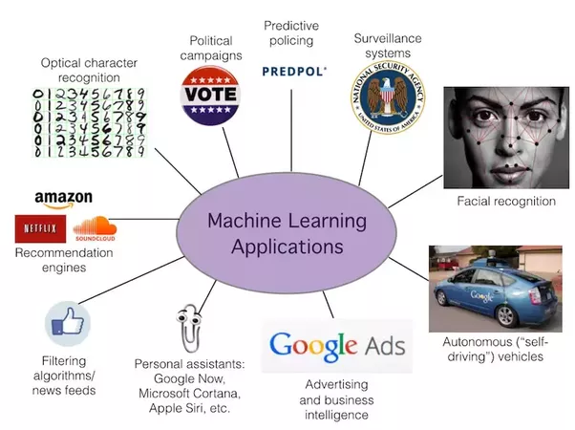
Common machine learning applications

Slide 9
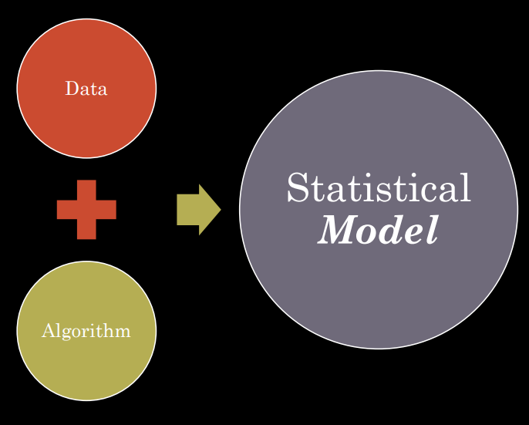
What is a model?
Apply an algorithm (a set of instructions) to data to progressively learn and recognize patterns to solve a business problem.
The resulting model is a statistical structure that can be used to solve the problem. For example, a model predicts an outcome when presented with new data.

Slide 10
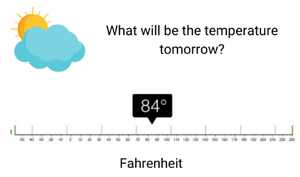
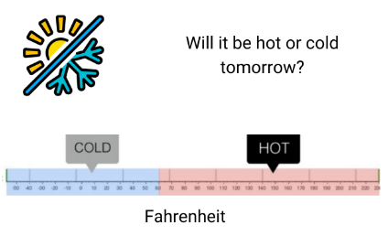
Common types of machine learning models
Regression
Classification

Slide 11
What tools are available for data science and machine learning?
Notebook (Jupyter)
Canvas tool (SPSS)
AutoML (AutoAI)
Hand code data preparation, model selection, and algorithms
Support for compiling/running one process at a time to ease testing and debugging
Visual tool for assembling components to train and run a predictive model
Combines no-code and low-code approach to meet the needs of data scientists
Fully automated approach to data ingestion, model selection, feature selection, and training model candidate pipelines
Allows for rapid prototyping or extends ML capabilities for business analysts as well as data scientists

Slide 12
Building a machine learning model with Python
Predicting happiness by country

Slide 13
Major model-building tasks
Account for missing values
Choose a ML algorithm
Choose algorithm for regression problem
Test your model
Make predictions by using unseen data
Review the results
Assess the accuracy of your model as tested with holdout data
Define your goals
Prepare the data
Train your model
Train your model by using training data
Refine the data
What do you want to find out?

Slide 14
Defining the goal
1. Can we make a machine learning model that helps us predict the happiness score for a country based on multiple variables?
2. How do each of the features described in the data set affect the happiness score?

Slide 15
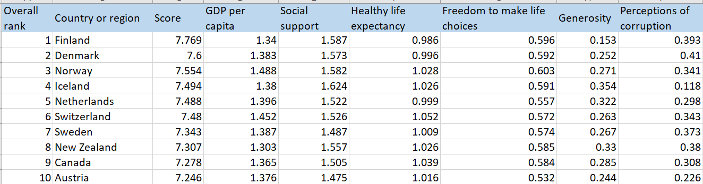
This data set includes a set of metrics and key indicators the contribute to a "happiness score" by country.
Analyzing the data set
Each column of data is a feature.
Our job is to construct a model that considers and weighs the inputs for a new country to predict a happiness score.
Because the Score is a number, rather than a choice of options, this is a regression problem, which affects the choice of algorithm

Slide 16
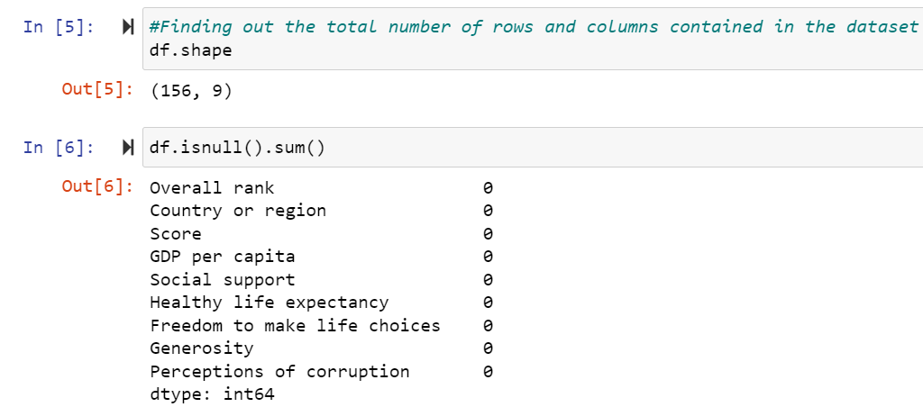
Preparing the data set
These cells list the columns and rows in the data set and check for null values to see if data imputation (supplying missing values) is required.
No null values for any of the columns

Slide 17
Choosing the model type and algorithm
We select Linear Regression as our algorithm.
Linear regression analysis is used to predict the value of a variable based on the value of another variable.
The variable you want to predict is called the dependent variable. The variable you are using to predict the other variable's value is called the independent variable.
Common variations:
Linear Regression
Multiple Linear Regression
Multivariate linear regression
Other regression algorithms:
Ridge Regression
Lasso Regression

Slide 18
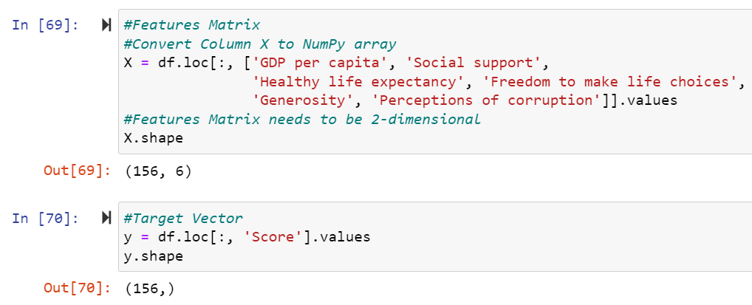
Selecting features (columns)
Features are the columns that affect the prediction. A data scientist will assess the relative importance of features.
Selecting input features from the data set
Selecting output feature from the data set

Slide 19
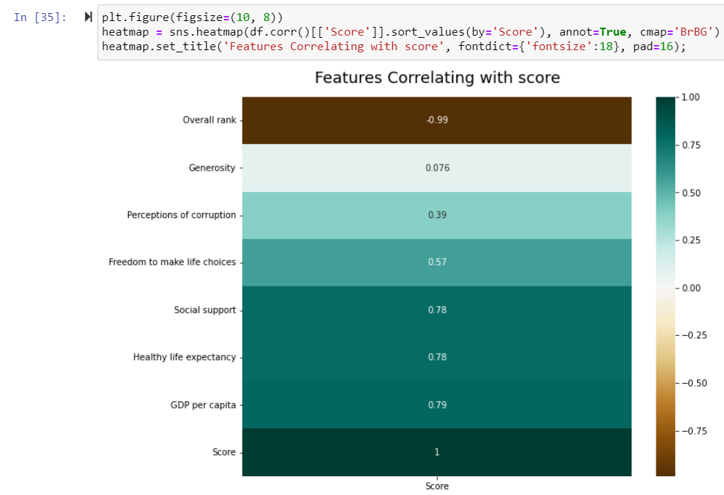
Not all features are equal...
Feature selection is the process of reducing the number of input variables when developing a predictive model.
The number of input features can be reduced to save computational cost of modelling.
Generosity has a weak correlation with Score
Notes:
Notes about correlation matrices:
1.Each cell in the grid represents the value of the correlation coefficient between two variables.
2.The correlation value of a variable with itself is always equal to 1.
3.The axes ticks denote the feature each of them represents.
4.A large positive value (near to 1.0) indicates a strong positive (direct) correlation, i.e., if the value of one of the variables increases, the value of the other variable increases as well.
5.A large negative value (near to -1.0) indicates a strong negative (inverse) correlation, i.e., the value of one variable decreases with the other’s increasing and vice-versa.
6.A value near to 0 (both positive or negative) indicates the absence of any correlation between the two variables, and hence those variables are independent of each other.
7.Each cell in the above matrix is also represented by shades of a color. Here darker shades of the color indicate smaller values while brighter shades correspond to larger values (near to 1). This scale is given with the help of a color-bar on the right side of the plot.

Slide 20
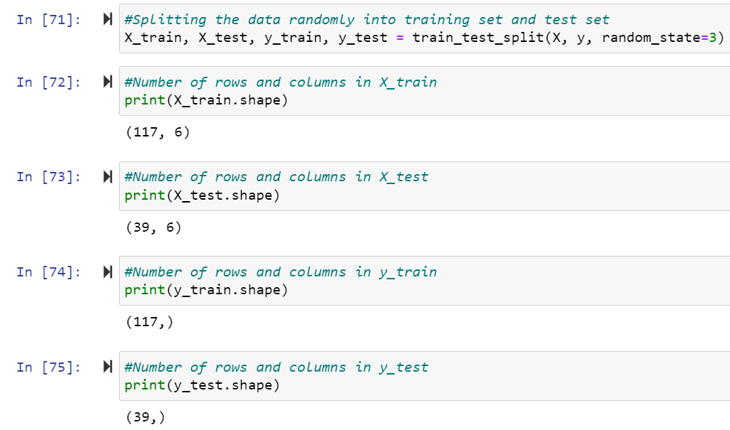
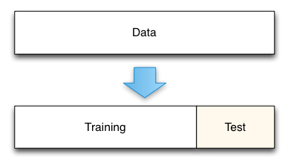
Dividing the data for training and testing
Most data is used to train the model. A percentage of test or holdout data is reserved to measure the performance of the model.

Slide 21
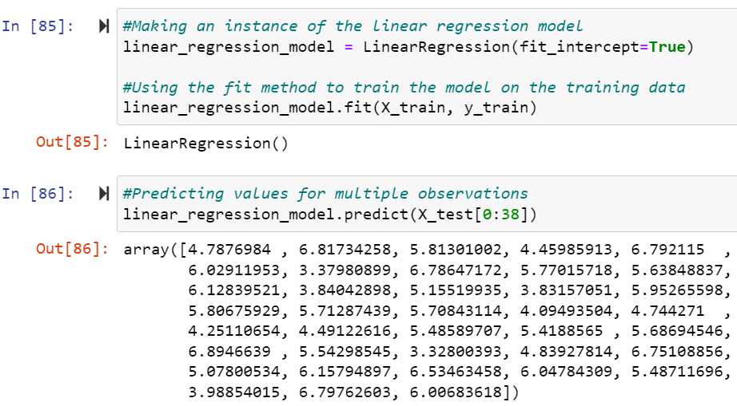
Building the Linear Regression model
The LinearRegression algorithm processes the training data and determines the relationship between the values.
Training the model
Testing (making predictions) with the model

Slide 22
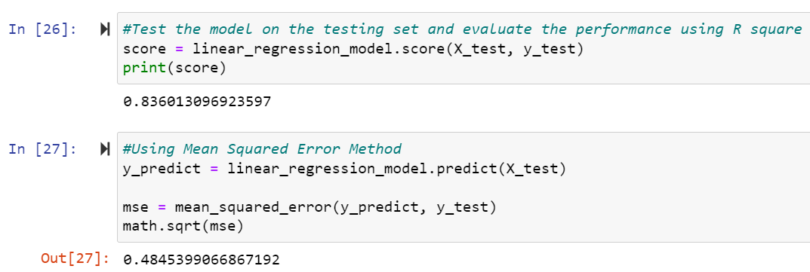
Measuring model performance
The R² score measures "fit", or how well the model explains the observed data. A higher score (closer to 1) is typically better.
MSE measures the difference between the observed values and the predicted ones. Lower is better.

Slide 23
Building a machine learning model with AutoAI

Slide 24
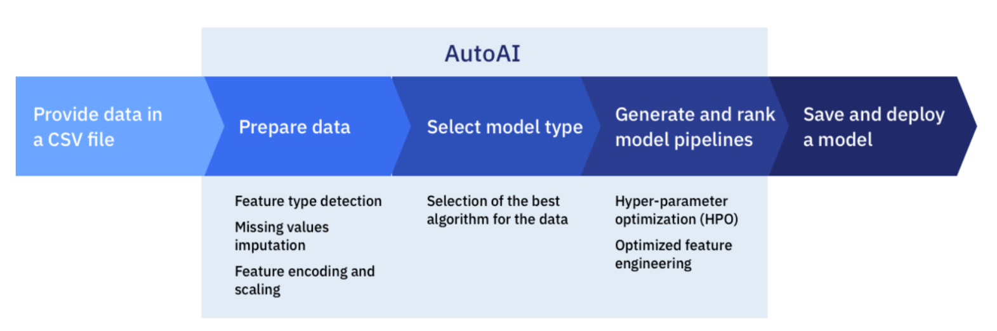
Major model-building tasks with AutoAI

Slide 25
Speeding up the process
Demo: Model building with AutoAI

Slide 26
Comparing the results

Slide 27
Experiment results
Parameter | Hand-coded model | AutoAI
Tools | Jupyter, scikit-learn, python | AutoAI
Pipelines / model(s) generated | 1 | 8
Algorithms included | 1 | 2
Enhancements | None | Hyperparameter optimization Feature engineering
R² | 0.836 | 0.797
Mean Squared Error (MSE) | 0.48 | 0.30
Programming Skills Required | Moderate | None

Slide 28
Traditional model building vs automated model building
Hand-coded model
AutoML
Pros:
Data scientist remains in control of all decisions.
Model / configuration is explainable.
Cons:
Time consuming.
Requires programming skills as well as data science expertise.
Pros:
Speeding time to value.
Greater acceleration at scale.
Good for rapid prototyping.
Cons:
Processing capacity.
Model explainability.

Slide 29
Wrapping it up

Slide 30
Summary
Data science is fundamental to using information for effective decision-making and problem-solving. Automating the work of building a machine learning model accelerates the time from inception to production.

Slide 31
Thank you
You can check out AutoAI capabilities in Watson Studio at: https://dataplatform.cloud.ibm.com/login

Slide 32
Any questions?

Slide 33
Reference
Screen captures from the AutoAI experiment.

Slide 34
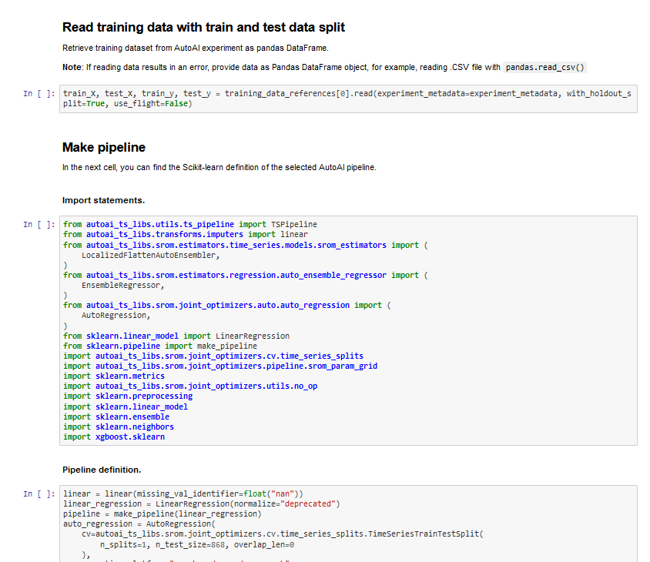
AutoAI model saved as a notebook

Slide 35
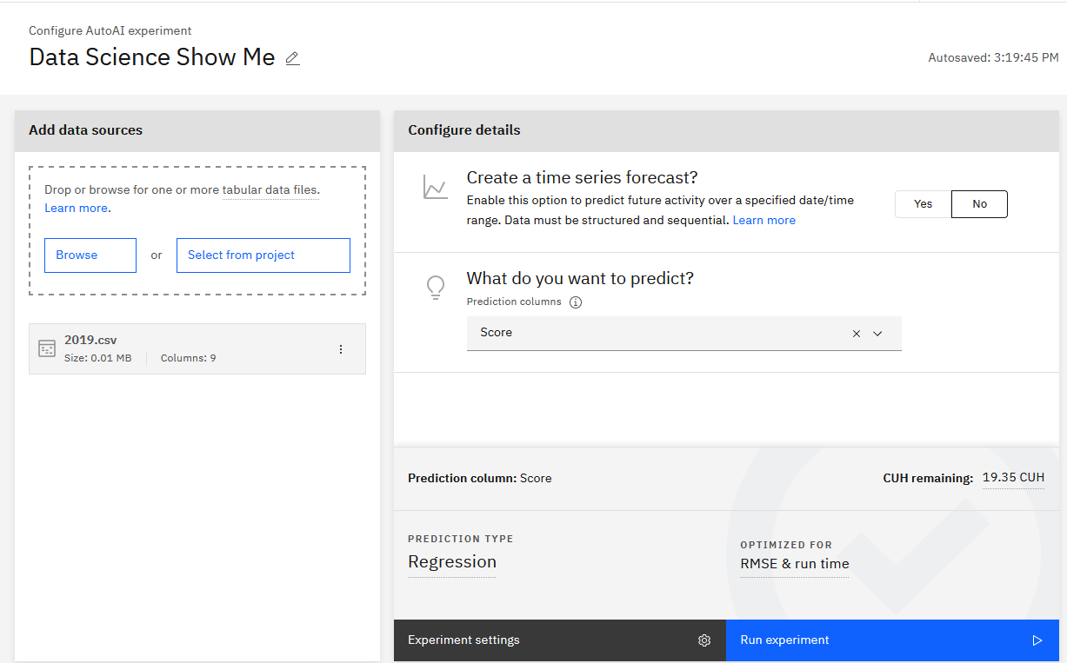
Experiment configuration
Review the data source, prediction, model type, and optimization metrics

Slide 36
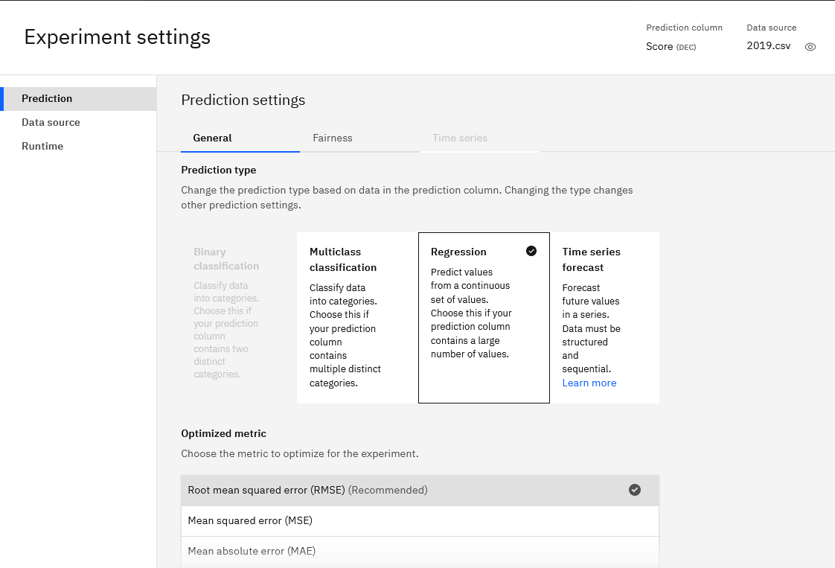
Automated choices for optimizing the experiment

Slide 37
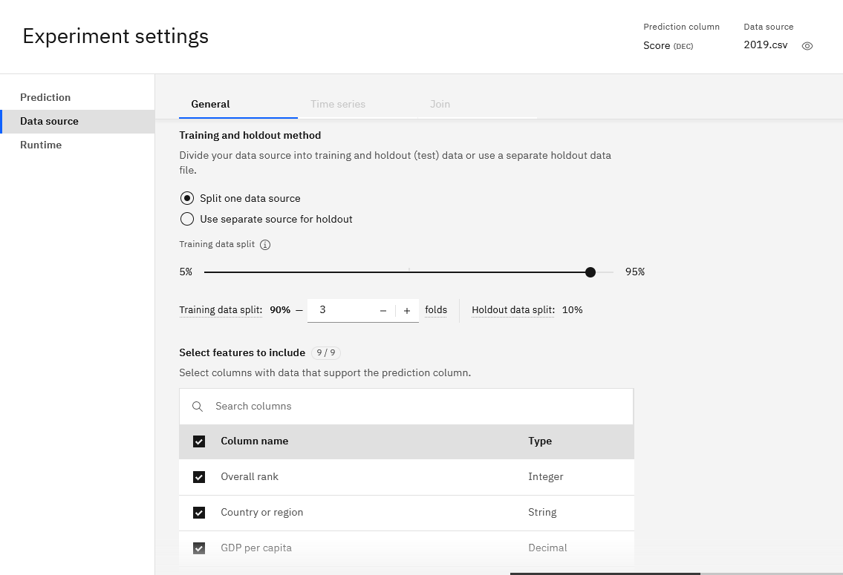
Data source details
Accept the defaults or make decisions about how to process the training data.

Slide 38
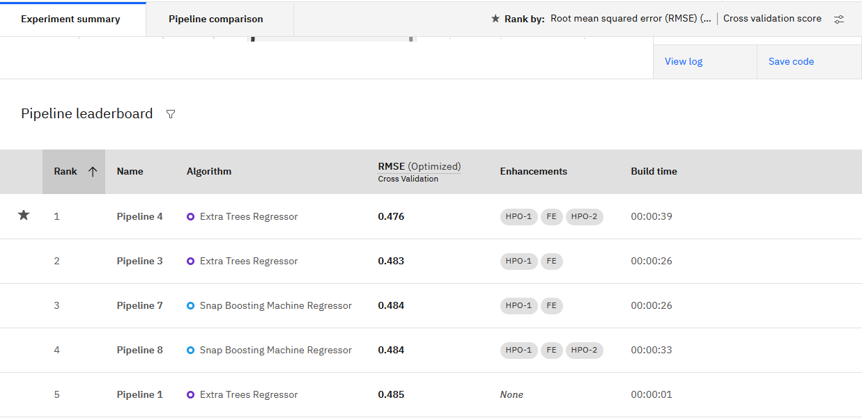
Pipeline leaderboard
The leaderboard ranks the pipelines so you can review and save the best as a model.

Slide 39
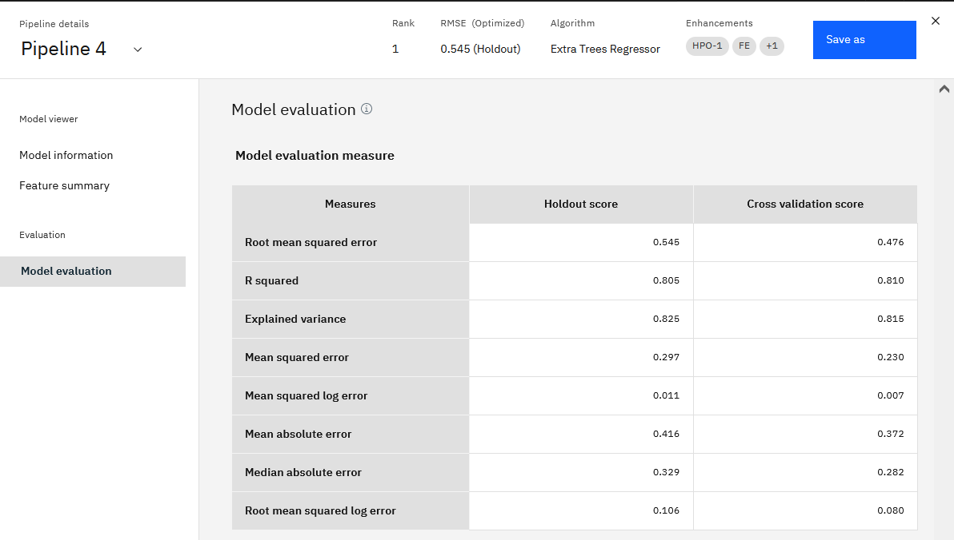
Details about the top pipeline

Slide 40
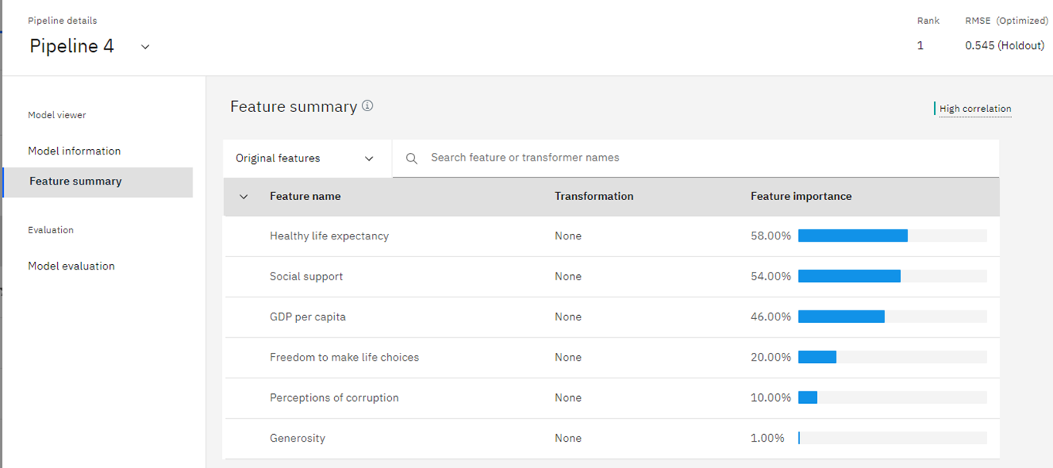
Feature importance
Which features have the greatest impact on the prediction?

